Slide 1



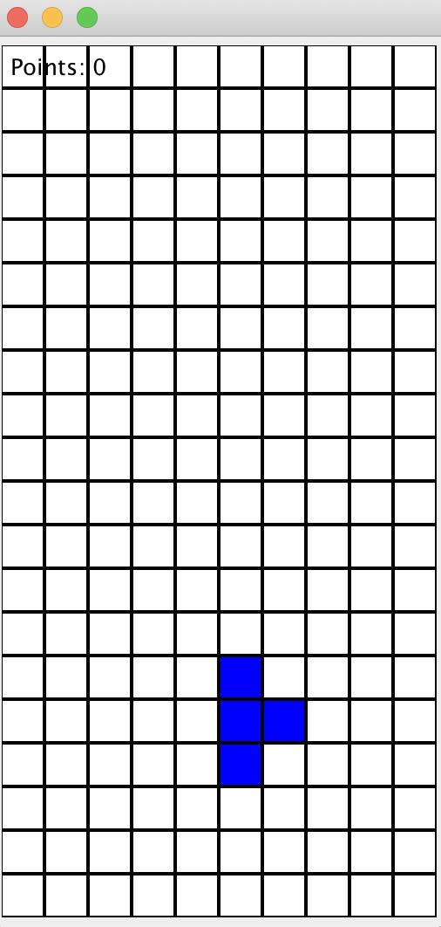
Tetris Game
Group 6 Khanh Phan, Shaista Usman, Yi Niu

Slide 2
JUnit Tests

Slide 5
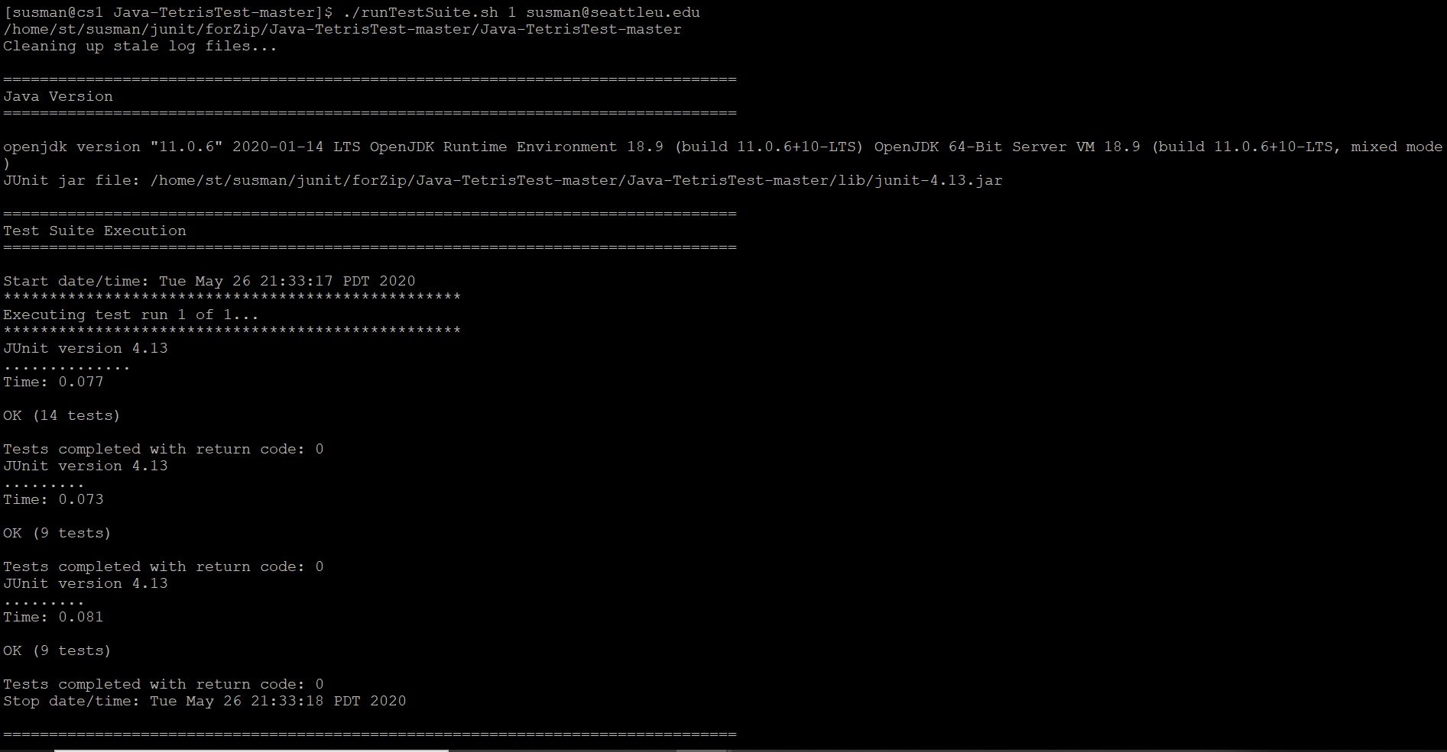
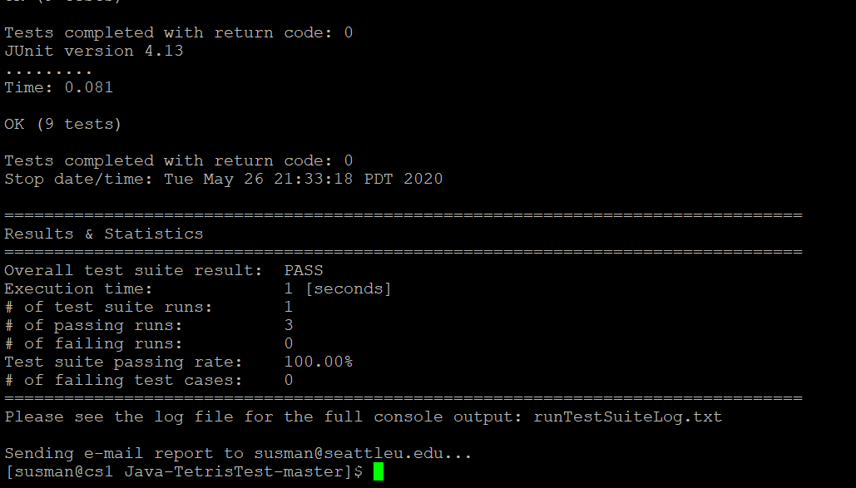
Regression Testing

Slide 6
Thank You!

